Slide 1
ORGANIC ACIDS 107. An organic acid will release H⁺¹ cations in solution, just like Arrhenius acids.
108. Organic acids contain the functional group called the – COOH group 109. Draw the functional group going to the left and to the right side.
“R” stands for the rest of the molecule, not the functional group.
R
R

Slide 2
110A. draw methanoic acid | B. draw ethanoic acid
C. draw propanoic acid | D. draw hexanoic acid

Slide 3
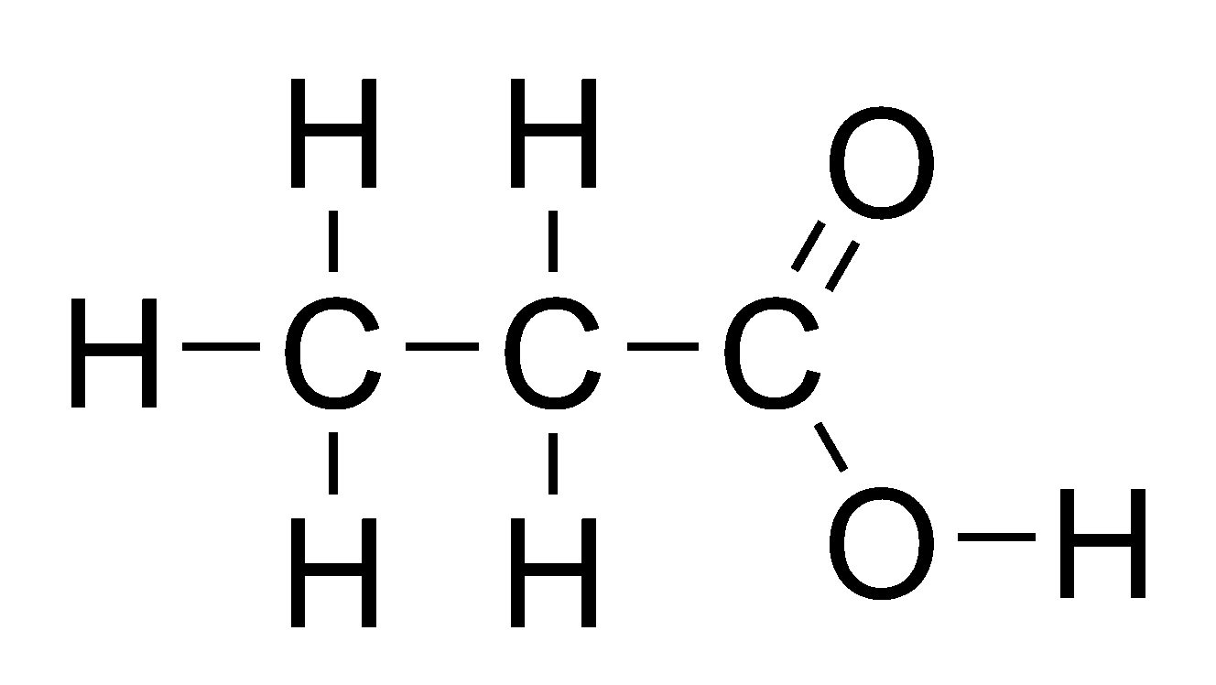
110A. draw methanoic acid | B. draw ethanoic acid
C. draw propanoic acid | D. draw hexanoic acid

Slide 4
110E. draw nonanoic acid

Slide 5
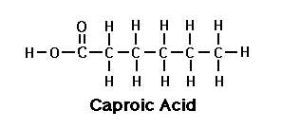
110E. draw nonanoic acid

Slide 6
111. The whole list of acids in high school includes
# carbon atoms | Name | Condensed Structural formula
1 | Methanoic acid | HCOOH
2 | Ethanoic acid | CH₃COOH
3 | Propanoic acid | CH₃CH₂COOH
4 | Butanoic acid | CH₃(CH₂)₂COOH
5 | Pentanoic acid | CH₃(CH₂)₃COOH
6 | Hexanoic acid | CH₃(CH₂)₄COOH
7 | Heptanoic acid | CH₃(CH₂)₅COOH
8 | Octanoic acid | CH₃(CH₂)₆COOH
9 | Nonanoic acid | CH₃(CH₂)₇COOH
10 | Decaonic acid | CH₃(CH₂)₈COOH

Slide 7
112. Copy this chart… these are the same molecules with different names.
Acetic | Ethanoic
HC₂H₃O₂ | CH₃COOH
2C + 4H + 2O | 2C + 4H + 2O
These molecules are identical but have different names. Acetic is “inorganic” style. Ethanoic is “organic” style. But they are identical molecules. Both are weak acids, both are weak electrolytes, both are vinegar, both are the same thing with different names.

Slide 8
114. Draw propanoic acid “to the left” and “to the right”. Make sure you can see this in both directions.

Slide 9
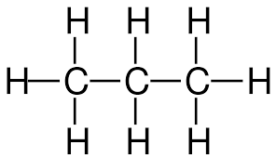
114. Draw propanoic acid “to the left” and “to the right”. Make sure you can see this in both directions.
O
O
OH
HO
– COOH group

Slide 10
ESTERS 115. The next functional group are the ESTERS. They tend to smell really good. They form from a reaction between an __________ and an _________.
116. This reaction is called ________________.
117. The ester functional group looks like this:
Make an “L” with your left hand. The “thumb” side is different than the hand side, right???
Hand side thumb side

Slide 11
ESTERS 115. The next functional group are the ESTERS. They tend to smell really good. They form from a reaction between an organic acid and an alcohol.
116. This reaction is called esterfication.
117. The ester functional group looks like this: →→ →→ →→
copy the box into your notes now…
Make an “L” with your left hand. The “thumb” side is different than the hand side, right???
Hand side thumb side

Slide 12
LAST NAME hand side
FIRST NAME thumb side
The ESTER group makes an “L” shape, like your hand. 118. The THUMB side, is the FIRST NAME side.
119. The other side is the hand side, or LAST NAME side.
120. We ALWAYS name ESTERS the THUMB SIDE first.

Slide 13
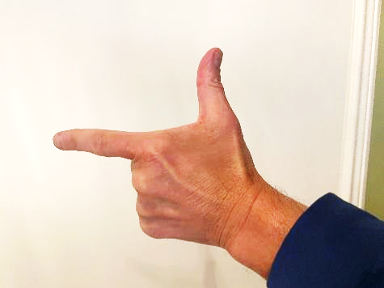
121
Thumb to the RIGHT Ester Functional Group
LAST NAME hand side
FIRST NAME thumb side
O
LAST NAME hand side
–– C – O ––
FIRST NAME thumb side

Slide 14
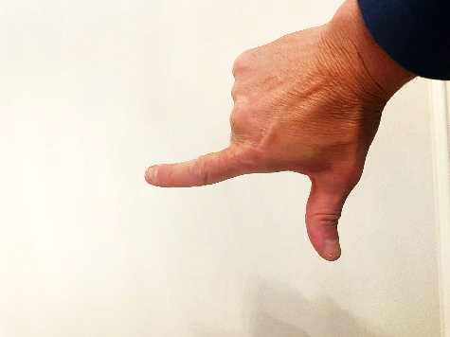
122
Thumb to the LEFT Ester Functional Group
–– O
FIRST NAME thumb side
LAST NAME hand side
O
FIRST NAME thumb side
–– O – C –––
LAST NAME hand side

Slide 15
123. Draw methyl propanoate (to the left + right) Start with the functional group in the middle of the box.
Functional group towards the right side | – C – O –
Functional group towards the left side | – O – C –
O
O

Slide 16
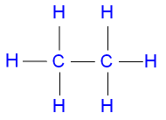
123. Draw methyl propanoate (to the left + right) Start with the functional group in the middle of the box.
Functional group towards the right side CH₃CH₂COOCH₃ | – C – O – Esters have a “COO” group
Functional group towards the left side CH₃OOCCH₂CH₃ | – O – C Esters have a “COO” group
O
O

Slide 17
124. Draw butyl pentanoate
Butyl is the first name, the THUMB SIDE Pentanoate is the last name, the HAND SIDE
O
―C―O―

Slide 18
124. Draw butyl pentanoate
O
―C―C―C―C―C―O―C―C―C―C―
Five carbons to the hand side
Four carbons to the thumb side
The carbon in the functional group COUNTS as part of the last name. Pentanoate has 5 carbons, including the functional group -COO.

Slide 19
Wednesday: Notes, 125-161
Then: Organic Chem Handout #2 (finish molecules, start reactions)
Lab count out back. If you are on the list, you owe lab reports. Tick Tock… not tiktok. I am nervous for some of you.

Slide 20
125. Draw these now…
Methyl hexanoate Ethyl methanoate

Slide 21
Methyl Hexanoate
125.
Ethyl methanoate

Slide 22
126. Now draw Ethyl propanoate and its isomer, Propyl ethanoate. These are NOT the same molecule.

Slide 23
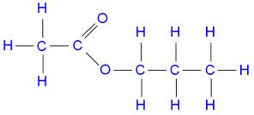
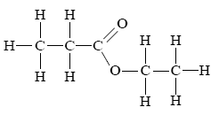
Propyl ethanoate 3—2
Ethyl propanoate 2—3

Slide 24
127. Final note, ALWAYS put in the “H” in the methanoate molecules. That “H” is mandatory. Otherwise, it looks like you either forgot to finish, or don’t know what to do at all. The “H” in the methanoate says YOU KNOW you’re done on that side.
Draw Propyl Methanoate

Slide 25
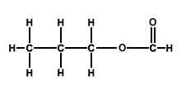
127. Draw Propyl Methanoate (shown “left and right”)

Slide 26
Amines and Amides are similar (in the same way aldehydes + ketones were).
128. The Amines + Amides both contain NITROGEN.
129. Count to 3 for nitrogen, N must always make 3 bonds.

Slide 27
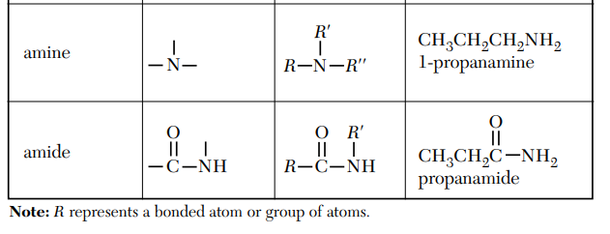
130. Amine groups can be on the end or in the middle of a hydrocarbon chain
131. Amide groups are always on the end of a chain. Change the table as shown now. In high school we only have simple with -NH₂
H
H
Middle or End
H
End only

Slide 28
132. Nitrogen atoms can form bonds of 3 chains, in our class they will always bond simply with one carbon, and two hydrogen atoms only. R––N–H H
This is the AMINE functional group R––NH₂
“R” means one carbon, or up to 10 carbons, just ALKANES.

Slide 29
133. Nitrogen atoms always make 3 bonds In amides, the “NH₂” part bonds to a carbon double bonded to oxygen. Fancier. R––C–N–H H
O
This is the AMIDE functional group O R––C–NH₂

Slide 30
134. draw methanamine | 135. draw methanimide
136. draw ethanamine | 137. draw ethanamide
138. draw 3-pentanamine | 139. draw pentanamide (no number?)

Slide 31
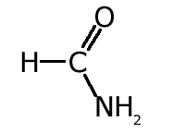
136. draw methanamine | 137. draw methanamide
138. draw ethanamine | 139. draw ethanamide
140. draw 3-pentanamine NH₂ CH₃CH₂CHCH₂CH₃ | 141. draw pentanamide (no number?) O CH₃CH₂CH₂CH₂C ̶ NH₂

Slide 32
Organic Chem Class 6
Objective: Examining and Mastering all of the Organic Chemical Reactions:
Substitution, Addition, Fermentation, Esterfication, Polymerization and Saponification

Slide 33
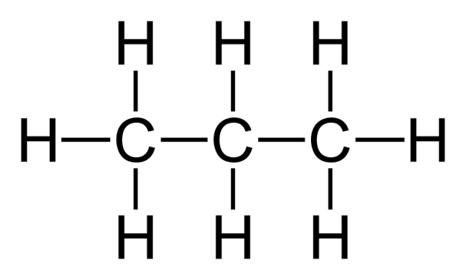
We have seen substitution reactions last week when we discussed the formation of halocarbons. We need to stick halogens (F, Cl, Br, or I) into a saturated hydrocarbon.
Being saturated, there is NO ROOM for any new atoms, so we need to substitute in one halogen atom for a hydrogen atom.
140. Substitution reactions:
Saturated + Halogen → Halocarbon + HX Hydrocarbon
(alkane) + (F, Cl, Br, or I) → Halocarbon + HX
Propane + F₂ 1-fluoropropane + HF
+ F₂

Slide 34
140.
Propane + F₂ 1-fluoropropane + HF
+ F₂
F + HF

Slide 35
Draw these 2 substitution reactions with structural diagrams and NAME the products properly.
141. Ethane + chlorine yields…
142. Butane + iodine yields 2-iodobutane + HI

Slide 36
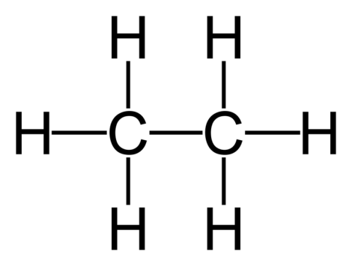
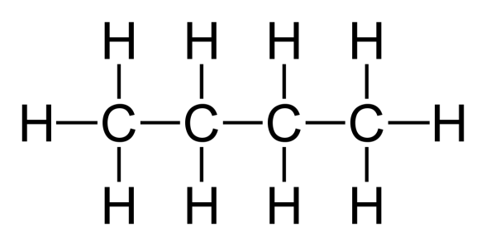
141.
Ethane + chlorine yields chloroethane + HCl
142. Butane + iodine yields 2-iodobutane + HI
+ Cl₂
Cl + HCl
+ I₂
+ HI
I

Slide 37
ADDITION reactions start with a halogen and a UNSATURATED hydrocarbon (an alkene or alkyne). We ADD the halogen into it, FORM ONE PRODUCT.
143. Draw and write the structural diagrams for: Ethene + Bromine yields 1,2 dibromoethane

Slide 38
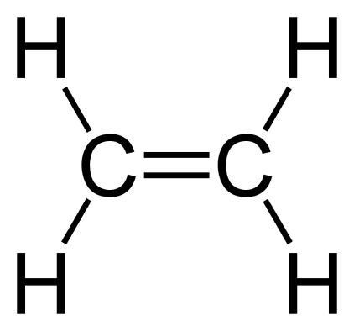
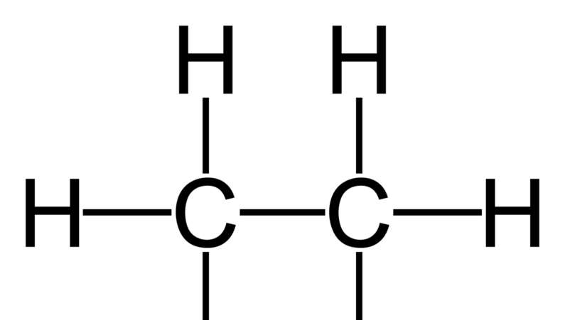
143. Ethene + Bromine yields 1,2 dibromoethane
+ Br₂
Br Br
Here, the double bond opens, making room to add both atoms of bromine, simultaneously. The Br’s get added one to each of the carbon atoms.

Slide 39
144. Draw Propene + chlorine → 1,2dichloropropane
145. Ethyne and fluorine → 1,2 difluoroethene

Slide 40
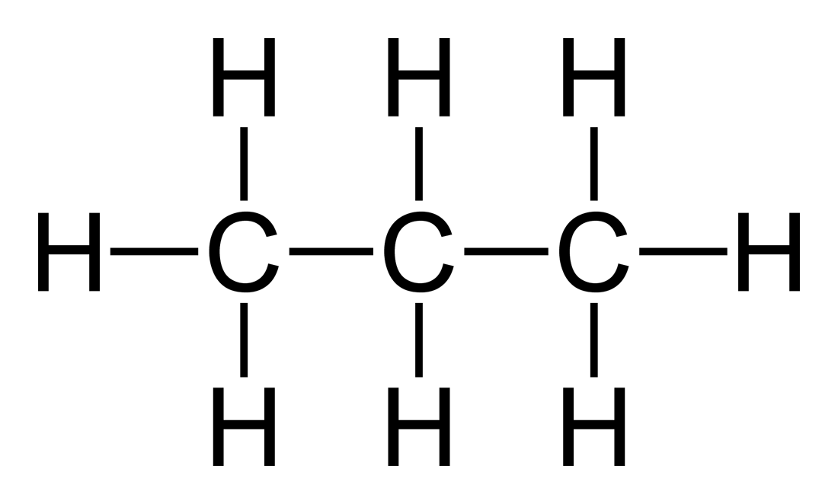
144. Propene and chlorine yields 1,2 dichloropropane
145. Ethyne and fluorine yields 1,2 difluoroethene
Cl
+ Cl₂
Cl
F F
+ F₂
H—C=C—H

Slide 41
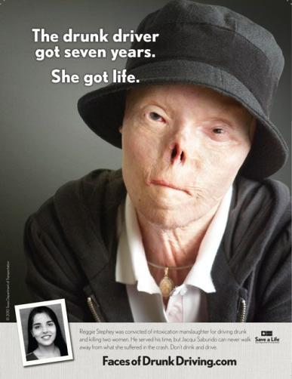
Fermentation is an organic chemical process known to humans for 1000’s of years. It turns juices into ethanol and carbon dioxide. That’s how to make champagne, or wine, or beer, or stronger liquors.
It’s a billions of dollars a year industry around the world, it’s wonderful in small amounts - when you’re over 21.
It can be terrible too.
It makes you think weirdly. It can make you angry, it certainly makes you stupider in the moment.
It makes you unsafe.
Don’t drink alcohol until you’re 21. Never, ever drive drunk.
Never, ever get in a car if the driver has been drinking. Never ever, not with anyone, no matter what.

Slide 42
146. Fermentation is the organic chemical reaction that YEAST turn sugar into ethanol and carbon dioxide.
147. Yeast excrete waste products called ethanol + CO₂ during anerobic respiration.
148.
yeast enzymes
in water
Sugars CH₃CH₂OH + CO₂
Ethanol alcohol and carbon dioxide

Slide 43
There are many kinds of sugars, but we will use GLUCOSE to show fermentation.
149. Balance this reaction: glucose forms ethanol and carbon dioxide gas.
C₆H₁₂O₆ ^{in yeast with water} __________ + ___________

Slide 44
There are many kinds of sugars, but we will use GLUCOSE to show fermentation.
149. Balance this reaction: glucose forms ethanol and carbon dioxide gas.
C₆H₁₂O₆ ^{in yeast with water} 2CH₃CH₂OH_{(AQ)} + 2CO_{2(G)}

Slide 45
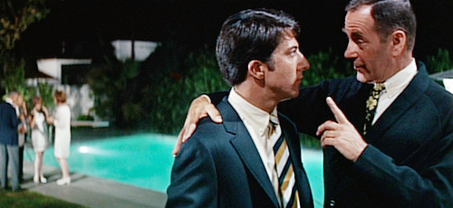
150. Polymerization the process of making plastics.
Here is a shot from the movie “The Graduate” with Dustin Hoffmann (he’s the guy on the left).
At Ben’s college graduation party he talks to Mr. Robinson, who is Ben’s fathers’ law partner. Mr. Robinson gives some advice to the young Ben, and the line is this…
“I have just one word of advice for you. Are you listening to me Ben?”
“Yes.“ Ben replies. Mr. Robinson says:
“Plastics.”

Slide 46
151.
Polymerization
mer
means
unit or body
poly means many
-ization
means the
process of
the organic chemical reaction of making plastics or polymers.

Slide 47
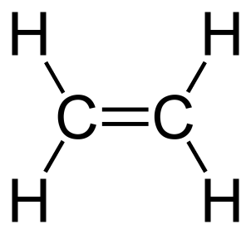
A “mer” is a molecule or “unit”
A “mer”
ethene molecule

Slide 48
153. A lot of “mers” (a lot of ethene molecules)
ethene molecules
can form long chains of a polymer called polyethene
catalyst
n
Catalysts break open those double bonds, allowing the “mers” to unite into chains that go on and on, and are indefinite in length. There is not a “real” formula for the polymer formed.
the polyethene formula is (–CH₂CH₂–)_{n}

Slide 49
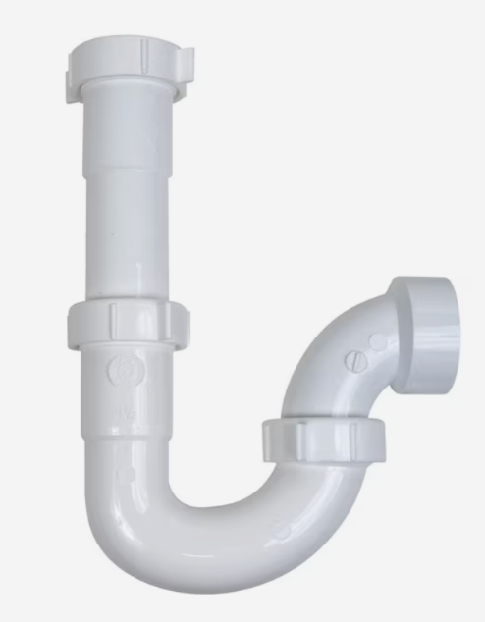
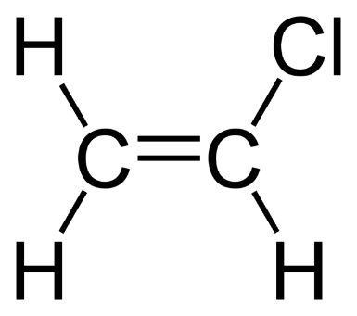
154. Other plastics that you probably know of already are
PVC, or polyvinyl chloride is the OLD-FASHIONED name for the plastic white pipes which are used for plumbing in your home.
It starts out with CHLOROETHENE as the “mer”. It forms POLYCHLORETHENE PVC is the old name for it.
( )_{n} →

Slide 50
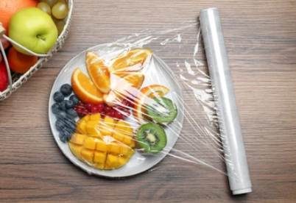
154. Other plastics that you probably know of already are
Polyethylene is what thin, soft clear plastic food bags are made of ethene molecules (sandwich wrap plastic).

Slide 51
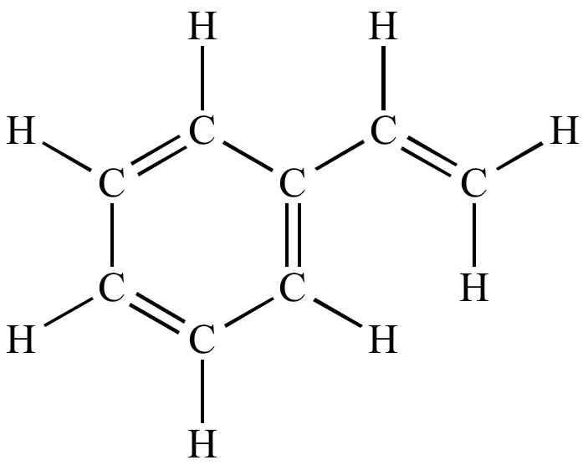
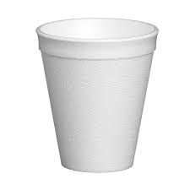
154. Other plastics that you probably know of already are
Polystyrene (Styrofoam) is another plastic you have used. This one is white + opaque.
This molecule (mer) is styrene
The “H” atoms come off and more styrene molecules link together, like a chain link fence, to make Styrofoam.

Slide 52
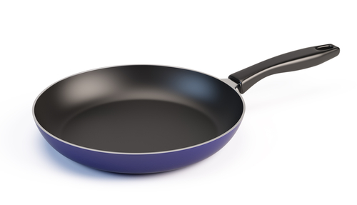
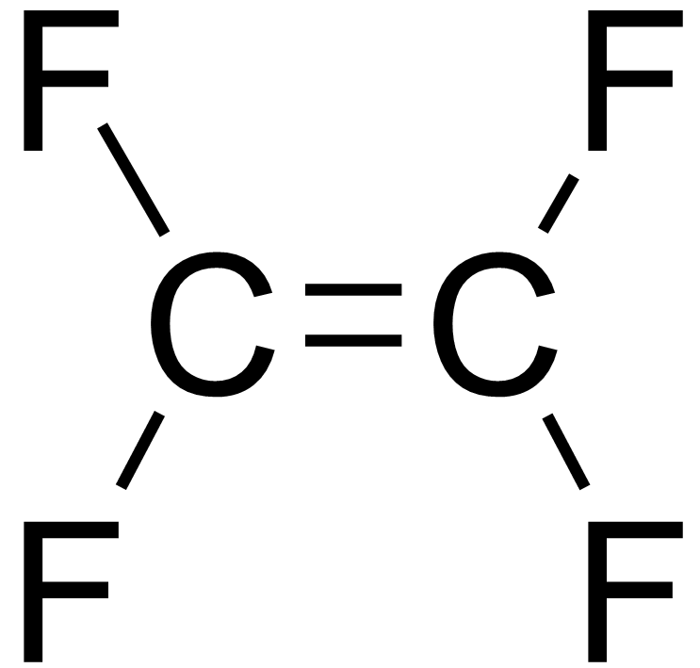
154. Other plastics that you probably know of already are
Teflon (used in frying pans) is Polytetrafluoroethylene. The “mer” is CF₂=CF₂ which you’d call tetrafluroethene
This is the “mer”

Slide 53
ESTERIFICATION The molecules “face” each other, functional groups close, and we take out HOH (water). The rest of the molecules then bond together making an ester with that famous COO group in the middle making an “L” shape.
155. organic acid + alcohol → ester + HOH
156. Combine propanoic acid + ethanol (use structural diagrams, not formulas – draw)

Slide 54
156. we will combine propanoic acid + ethanol
+
OH

Slide 55
156. we will combine propanoic acid + ethanol
H H
+
HO
C
C
H
OH
H H
Acids will ionize the hydrogen in the –COOH group. Alcohols do not ionize at all. To form water, something a bit odd happens.

Slide 56
156. we will combine propanoic acid + ethanol
H H
+
HO
C
C
H
OH
H H
HOH (water) +
The acid provides the –OH, while the alcohol provides the H, to make HOH.
Odd since acids usually provide H+1 ions, and alcohols are NOT ionic at all. Odd.

Slide 57
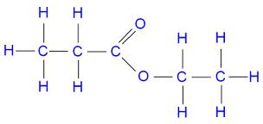
156. we will combine propanoic acid + ethanol
H H
+
HO
C
C
H
OH
H H
HOH (water) +
Ethyl Propanoate

Slide 58
157. Draw the reactant molecules and product molecules (and product names)
butanoic acid + 1-propanol form an ester + water

Slide 59
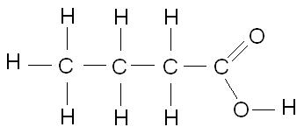
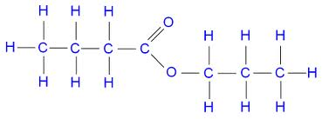
157. Draw the reactant molecules and product molecules (and product names)
butanoic acid + 1-propanol form an ester + water
H H H
+
HO
C
C
C
HOH +
H
OH
H H H
Propyl Butanoate

Slide 60
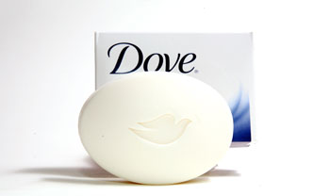
I use that stuff
158. SAPONIFICATION is the most complex reaction but the easiest to recognize and remember. If you misspell this reaction the first four letters might spell out SOAP.
In fact, this organic reaction is the reaction that makes SOAP. (the take a bath kind) Did I say SOAP?

Slide 61
159. The word equation for making soap is always...
A triple ester* molecule combines with 3 strong bases, forming a triple alcohol and 3 soap molecules.
THREE is our lucky number.
*Sometimes a triple ester is called a FAT
Soap molecules are not really molecules, they contain a metal cation. Soaps are “charged particles” that are mostly nonpolar on one side, and very polar and AQ on the other.

Slide 62
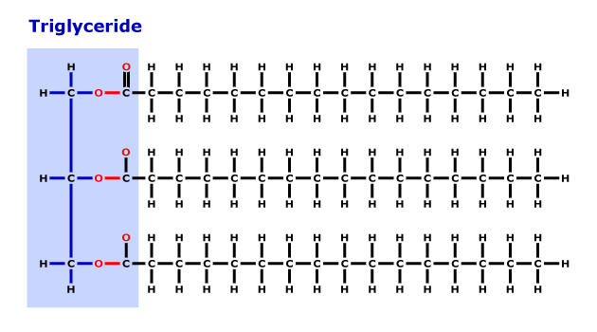
160. Reactants for saponification…
+ 3 NaOH →
You can use any 3 bases, different bases will result in different kinds of soap, softer, harder, liquid or solid, different colors, etc.
Circle the ester groups

Slide 63
161. (products) The products of saponification are SOAP and a triple alcohol. Note, the soap has a “triple” molecular shape, and contains an ION as well.
H
H – C – OH
H – C – OH
H – C – OH
+
3CH₃(CH₂)₁₆COONa⁺ ^{Only one shown in picture}
H
Triple Alcohol
We don’t have to name these molecules, just “recognize” them at the end of this equation.

Slide 64
Organic Chem Class #7
Objective: ISOMERS, and Branched Hydrocarbons
Drawing them, naming them, condensed structural formulas.

Slide 65
ISOTOPES are chemically identical atoms with different atomic masses (different # neutrons) which are the reason for average atomic masses being decimals.
ALLOTROPES, such as graphite and diamonds, both pure carbon They are bonded differently and have different properties. If you don’t believe that, try to take the regents with a diamond, or get engaged with a pencil!
167. ISOMERS are organic compounds with the same chemical formulas, but different structures. They have the same molar mass, but different properties.

Slide 66
168. Examples include ethanol and dimethyl ether Draw the structural + chemical formulas for these.
 | Structural diagrams | Condensed structural formulas
Ethanol
Dimethyl ether

Slide 67
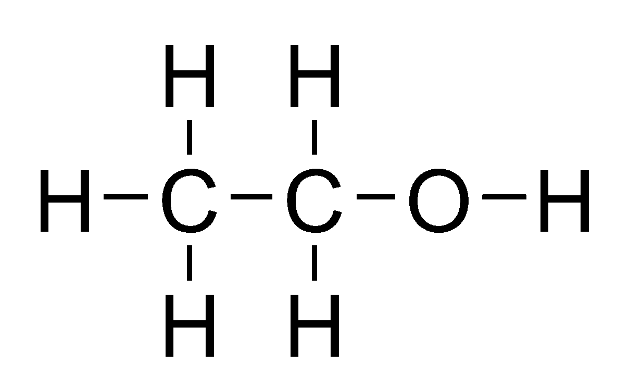
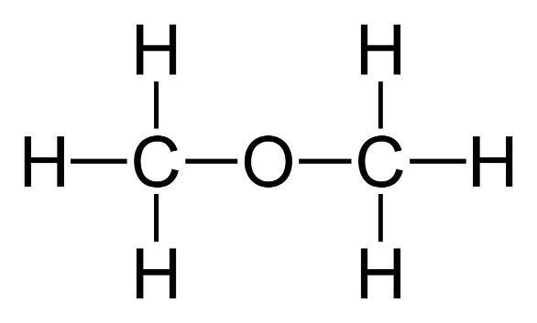
168. Examples are ethanol and dimethyl ether Draw the structural + chemical formulas for these.
 | Structural diagrams | Condensed structural formulas
Ethanol |  | CH₃CH₂OH (C₂H₆O)
Dimethyl ether |  | CH₃OCH₃ (C₂H₆O)

Slide 68
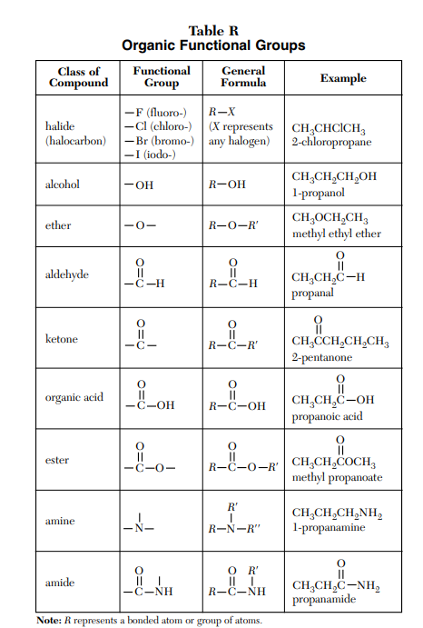
All alcohols with the same number of carbon atoms as an ether are isomers…
Ex: Hexanol (6) is isomer to methyl pentyl ether, and ethyl butyl ether, and
Dipropyl ether
All aldehydes with the same number of carbon atoms as a ketone are isomers…
Ex: Pentanal (5) is isomer to 2-pentanone or 3-pentanone
This should be marked in your reference tables already

Slide 69
Branched Hydrocarbons can also be isomers of each other.
169. Draw hexane Then pentane with a “methyl” group on the #2 carbon.

Slide 70
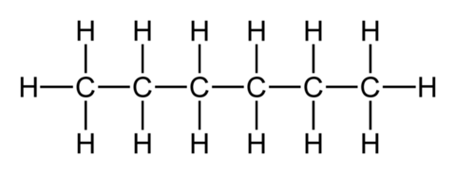
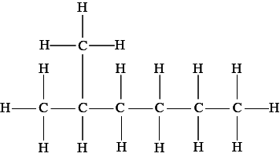
Branched Hydrocarbon Isomers.
169. This is hexane. C₆H₁₄
Draw pentane with a “methyl” group on the #2 carbon. This is methyl pentane. also C₆H₁₄

Slide 71
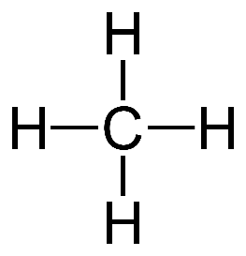
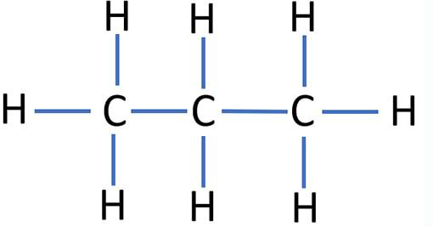
170. Draw this, name this, then draw an isomer of it.

Slide 72
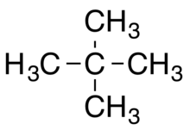
170. Dimethyl propane C₅H₁₂
Isomer to pentane, C₅H₁₂

Slide 73
171. Draw 4-methyl, 5-ethyl nonane

Slide 74
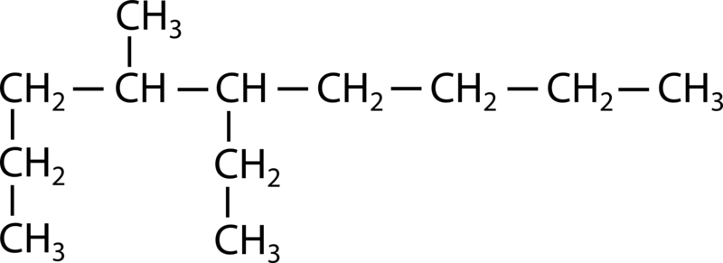
171. Draw 4-methyl, 5-ethyl nonane
Name the longest chain, then find the branches.

Slide 75
172. Draw 7ethyl, 8-fluoro, 2-nonyne

Slide 76
172. Draw 7ethyl, 8-fluoro, 2-nonyne
CH₃
CH₂
C ≡ C
F

